Slide 1


SOFTWARE ENGINEERING (Week-3)
USAMA MUSHARAF
MS-CS (Software Engineering)
LECTURER (Department of Computer Science)
FAST-NUCES PESHAWAR

Slide 2
AGENDA OF WEEK # 3
Case Study Discussion
Class Activities
Discussion on Assignment # 1
Quiz # 1
Requirement Engineering
Requirement Analysis (Structured Analysis)

Slide 3
BANKING SYSTEM CASE STUDY
A bank has several automated teller machines (ATMs), which are geographically distributed and connected via a wide area network to a central server.
Each ATM machine has a card reader, a cash dispenser, a keyboard/display, and a receipt printer.
By using the ATM machine, a customer can withdraw cash from either checking or savings account, query the balance of an account, or transfer funds from one account to another.

Slide 4
BANKING SYSTEM CASE STUDY
A transaction is initiated when a customer inserts an ATM card into the card reader. Encoded on the magnetic strip on the back of the ATM card is the card number, the start date, and the expiration date.
Assuming the card is recognized, the system validates the ATM card to determine that the expiration date has not passed, that the user-entered PIN (personal identification number) matches the PIN maintained by the system, and that the card is not lost or stolen.
The customer is allowed three attempts to enter the correct PIN; the card is confiscated if the third attempt fails. Cards that have been reported lost or stolen are also confiscated.

Slide 5
BANKING SYSTEM CASE STUDY
If the PIN is validated satisfactorily, the customer is prompted for a withdrawal, query, or transfer transaction.
Before withdrawal transaction can be approved, the system determines that sufficient funds exist in the requested account, that the maximum daily limit will not be exceeded, and that there are sufficient funds available at the local cash dispenser.
If the transaction is approved, the requested amount of cash is dispensed, a receipt is printed containing information about the transaction, and the card is ejected.
Customer records, account records, and debit card records are all maintained at the server.

Slide 6
AGILE DEVELOPMENT USING BANKING CASE STUDY
Assignment no 1:
Create a working plan for banking system case study using agile process model (Extreme programming). You are required to
Identify functional requirements (FR’s) from the case study and write User Stories for each FR in order to have detail understanding.
Create Iteration Plans.(optional)
Perform Test First Development (Write test descriptions for user story cards).

Slide 7
WHAT IS REQUIREMENT?
What is requirement?
The descriptions of what the system should do
services that it provides and the constraints

Slide 8
TYPES OF REQUIREMENTS
Functional requirements:
statement of services
how system reacts to input
how system behaves in particular situation
Non-functional requirements:
constraints on services (timing, quality, security etc.)
Domain requirements
Inverse requirements
Inverse requirments means describing something in should not way. Sometime people find it easy to describe things in this manner. People like to describe what a system should not do instead of what a system should do
Design and implementation constraints

Slide 9
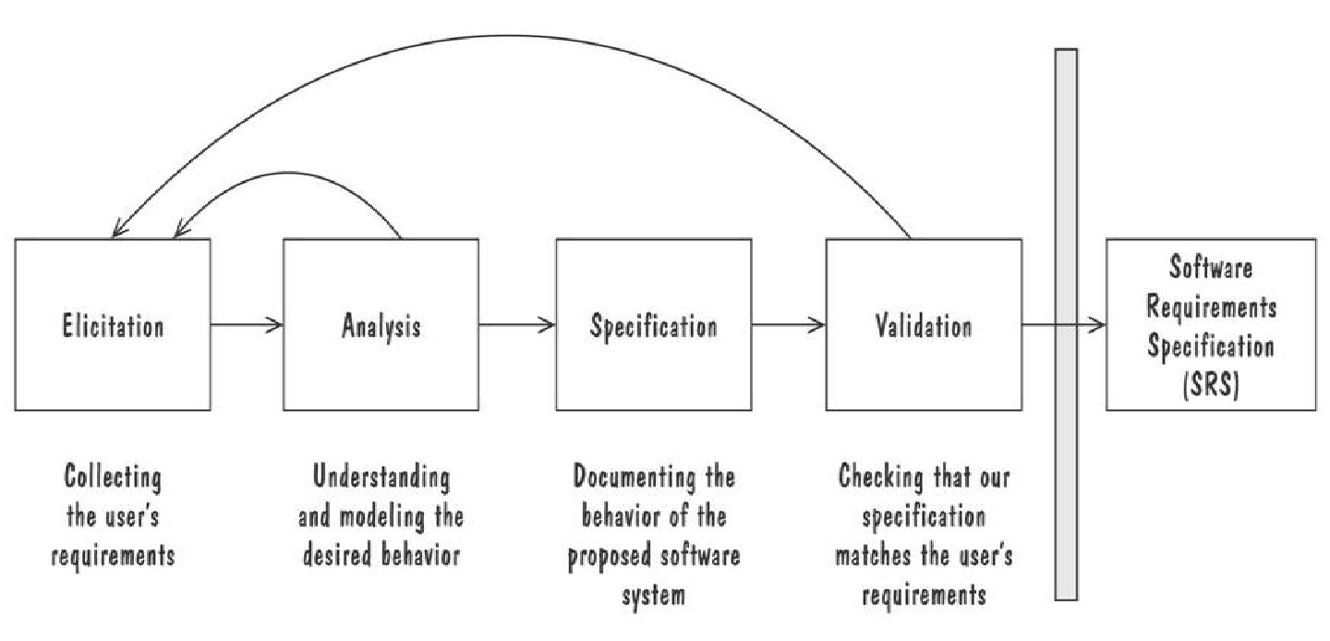
THE REQUIREMENTS PROCESS (PROCESS FOR CAPTURING REQUIREMENTS)
Performed by the req. analyst or system analyst
The final outcome is a Software Requirements Specification (SRS) document
Elicitation mean gathering data using communication with customer but we have case study here .

Slide 10
REQUIREMENTS ELICITATION STAKEHOLDERS
Clients: pay for the software to be developed
Users: use the system
Domain experts: familiar with the problem that the software must automate

Slide 11
REQUIREMENTS ELICITATION MEANS OF ELICITING REQUIREMENTS
Interviewing stakeholders
Reviewing available documentations
Observing the current system (if one exists)
10

Slide 12
ANALYSIS MODELING
Notes:
27

Slide 13
ELEMENTS OF THE ANALYSIS MODEL
Object-oriented Analysis
Structured Analysis
For the Oop we have Uml diagram but when we functional languages we used the Data flow diagrams but make first context diagrams.
Scenario-based
modeling
Flow-oriented
modeling
Use case text
Use case diagrams
Activity diagrams
Data structure diagrams
Data flow diagrams
Class-based
modeling
Behavioral
modeling
Class diagrams
CRC models
Collaboration diagrams
State diagrams
Sequence diagrams

Slide 14
FLOW-ORIENTED MODELING
Notes:
27

Slide 15
WHAT IS A DATA FLOW DIAGRAM?
A data flow diagram (DFD) is a graphical tool that allows system analysts (and system users) to depict the flow of data in an information system.

Slide 16
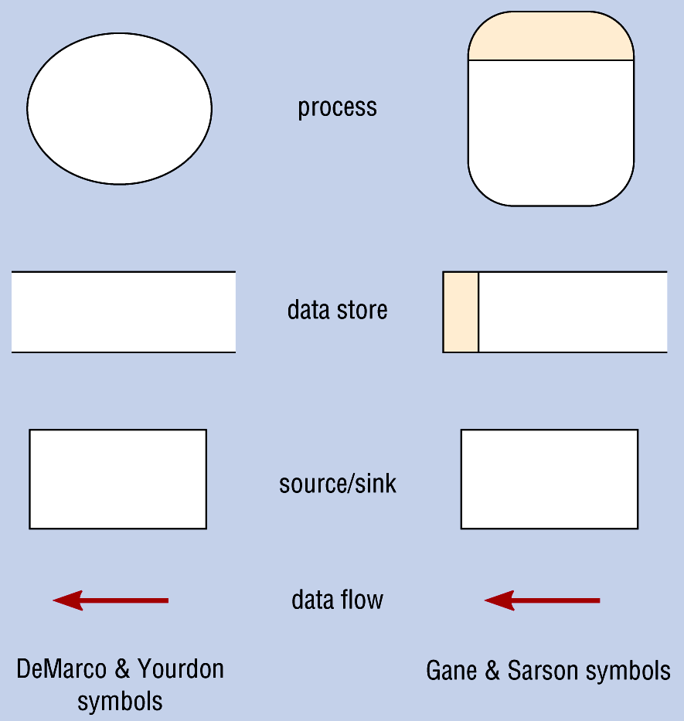
DATA FLOW DIAGRAM SYMBOLS
←We also use circle for the process
Source

Slide 17
STEPS IN BUILDING DFDS
Build the context diagram
Create DFD fragments
Organize DFD fragments into level 0
Decompose level 0 DFDs as needed

Slide 18
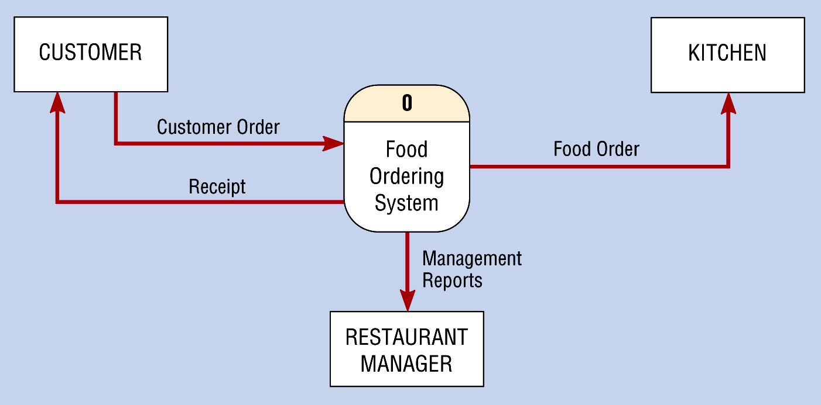
CONTEXT DIAGRAM OF FOOD ORDERING SYSTEM

Slide 19
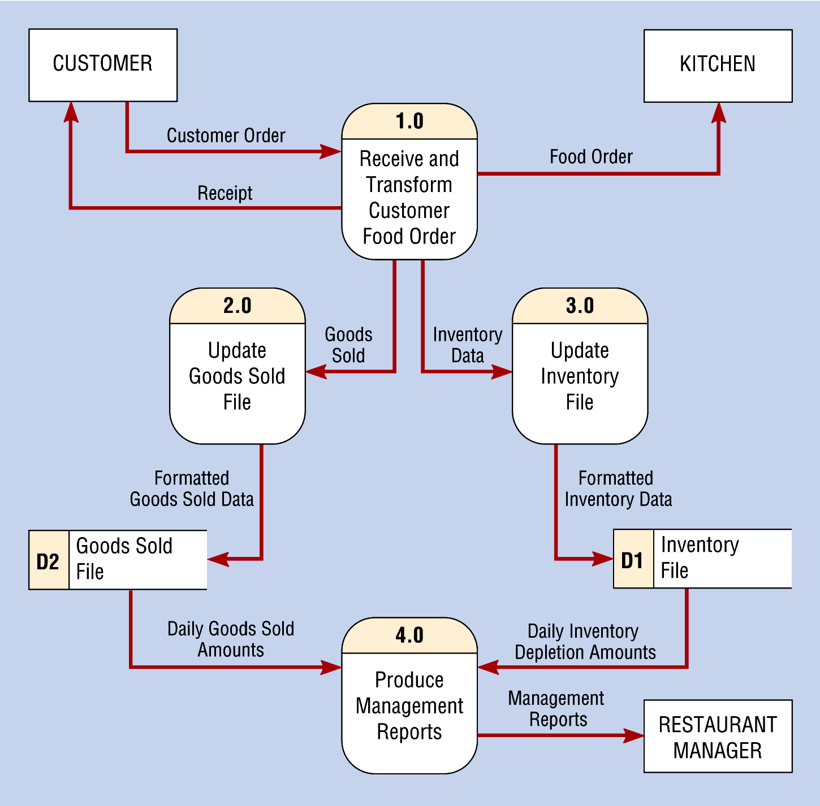
LEVEL-0 DFD OF FOOD ORDERING SYSTEM

Slide 20
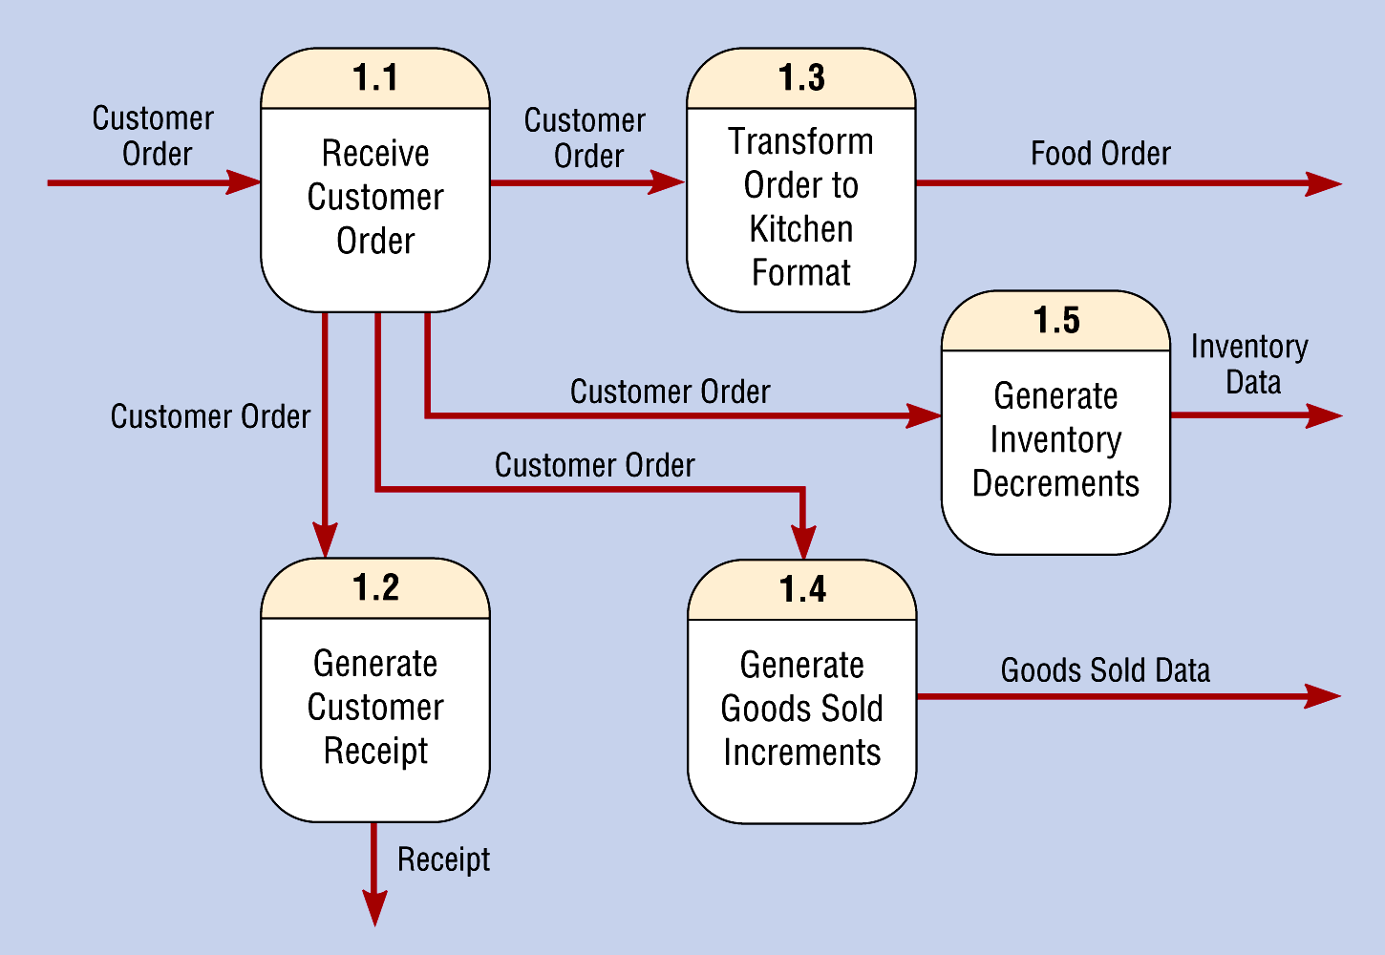
LEVEL-1 DIAGRAM SHOWING DECOMPOSITION OF PROCESS 1.0 FROM THE LEVEL-0 DIAGRAM

Slide 21
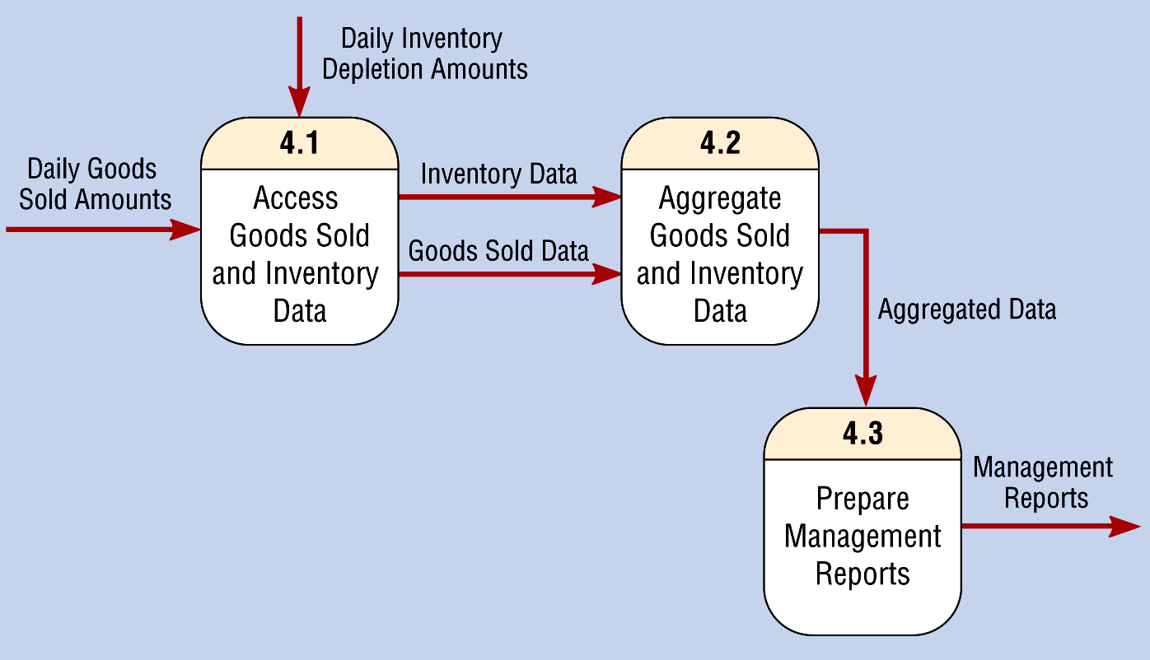
LEVEL-1 DIAGRAM SHOWING THE DECOMPOSITION OF PROCESS 4.0 FROM THE LEVEL-0 DIAGRAM
15-Mar-21

Slide 22
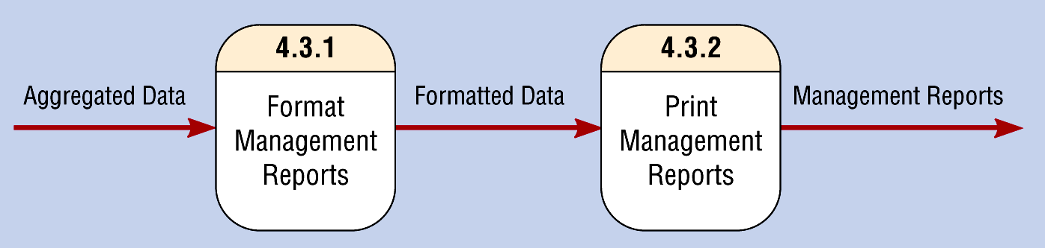
LEVEL-2 DIAGRAM SHOWING THE DECOMPOSITION OF PROCESS 4.3 FROM THE LEVEL-1 DIAGRAM FOR PROCESS 4.0

Slide 23
DATA FLOW DIAGRAM OF SAFE HOME SYSTEM
Notes:
27

Slide 24
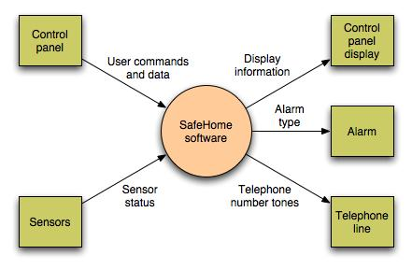
DATA FLOW DIAGRAM
Context-level DFD for SafeHome security function
Notes:
27

Slide 25
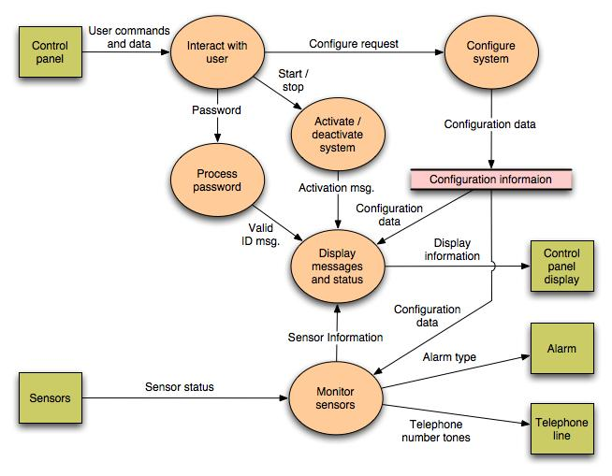
Notes:
27

Slide 26
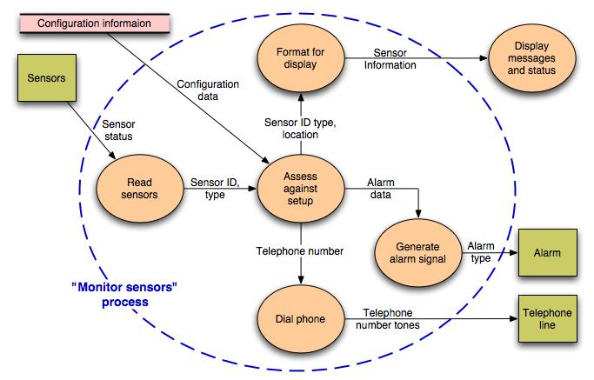
Level 2 DFD that refines the monitor sensors process
Notes:
27

Slide 27
HAVE A GOO DAY!

